Slide 1
Workshop 1: Getting Started-
Diversity and Identity

Slide 2
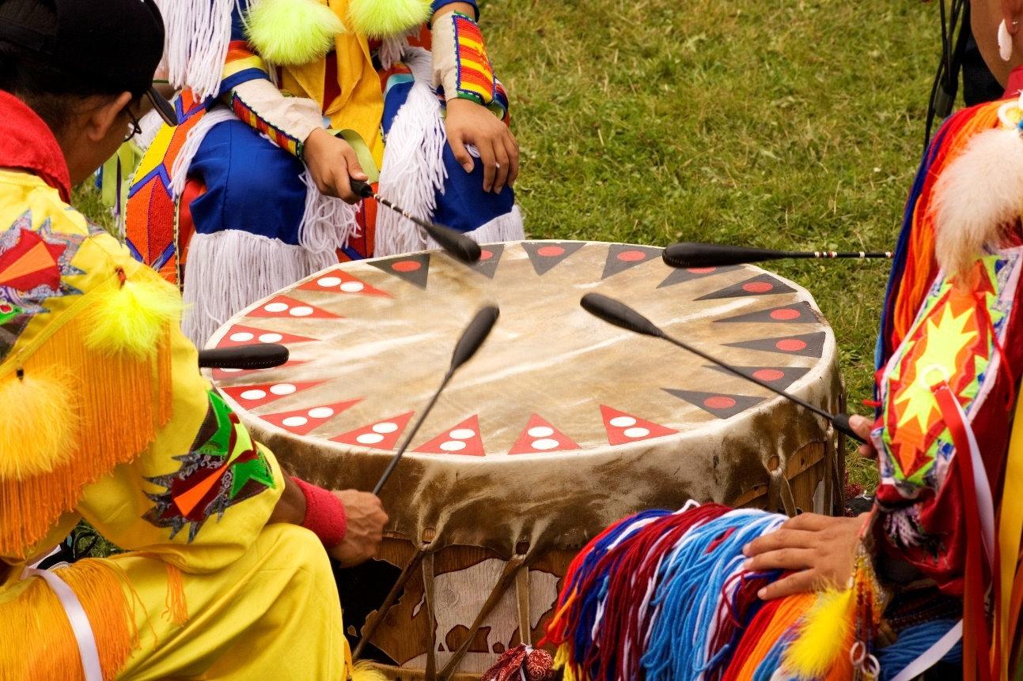
Indigenous Land Acknowledgment
Why is it important to acknowledge the land in which our school resides?

Slide 3
Pronoun Checks
Why do we do them?
Why are they important?

Slide 4
Community Commitments
https://www.youtube.com/watch?v=wuo13FrNX6g

Slide 5
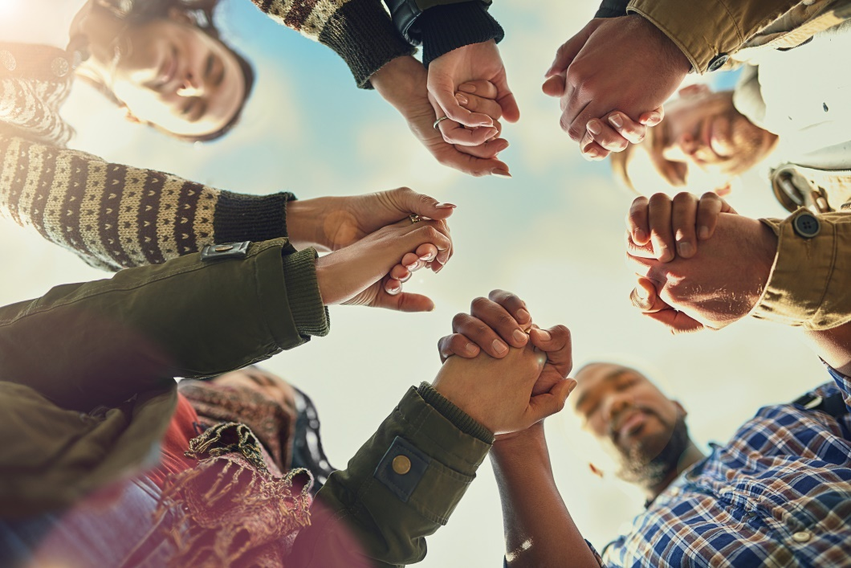
Community Commitments
Which commitments do we want to adopt?

Slide 6
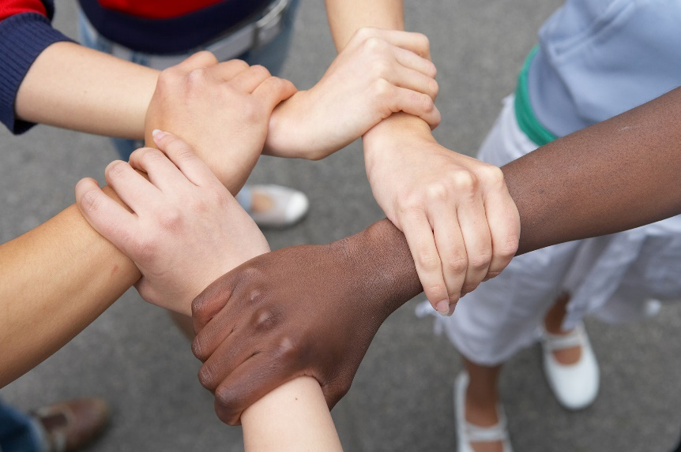
Community Commitments
Listening
Right to Pass
Appreciation
Confidentiality
Speak for Yourself
Right to “Ouch”

Slide 7
Icebreaker: Human Bingo

Slide 8
Diversity Kahoot Quiz
How much do you know about Canada’s diversity?
Text in to play!

Slide 9
Identity Iceberg
Adapted from Culture Matters: The Peace Corps Cross-Cultural Workbook

Slide 10
Identity Iceberg
Adapted from Culture Matters: The Peace Corps Cross-Cultural Workbook

Slide 11
Key concepts
We all have diverse talents, skills and experiences.
Canada is a diverse country. This diversity brings numerous challenges and assets to our society.
Diversity is a fact. Inclusion is a choice/action.
We all have complex identities, consisting of visible and invisible components.

