Slide 1
Workshop 3: Prejudice, Bias and Discrimination- How to Stop the Cycle

Slide 2
Community Commitments
Listening
Right to Pass
Appreciation
Confidentiality
Speak for Yourself
Right to “Ouch”

Slide 3
Key Concepts from Workshop 2
We need to value and recognize diversity to create equity.
We need to be aware of the contextual privileges that come with our identity and work to level the playing field.
Social movements have emerged by those who are working towards equity.
Social media has an important role in contemporary social movements.
Intersectionality ought to be considered when thinking about social change.

Slide 4
Reading Identity
Which of these individuals is a scientist, a dancer and an activist?

Slide 5
Reading Identity
Which of these individuals is a scientist, a dancer and an activist?
A
B
C

Slide 6
Worldview Role Play
Role Play activity created by Cathy Gallagher-Louisy,
Senior Director, Consulting, Canadian Centre for Diversity and Inclusion

Slide 8
Cycle of Prejudice
PREJUDICE They can’t
STEREOTYPE/BIAS They are
DISCRIMINATION We won’t
REACTION
VICTIM
OFFENDER
Copyright: Renée Bazile-Jones

Slide 9
Cycle of Prejudice: Example
PREJUDICE They can’t be:
Rational, good leaders, decisive
DISCRIMINATION We won’t:
hire them, promote them, let them manage men etc.
REACTION
STEREOTYPE/BIAS Women are emotional
VICTIM
OFFENDER
Copyright: Renée Bazile-Jones

Slide 10
Stereotype vs. Bias Part 1: Definitions
Stereotype- A false or generalized conception that results in conscious categorization of an individual or the members of a group (i.e. women are emotional)
Bias- An inclination or preference formed without reasonable justification that can prevent judgment from being balanced or even-handed (i.e. Asians are smart)

Slide 11
Cycle of Prejudice: Example of bias
PREJUDICE They can’t be:
Bad at math or get poor grades.
DISCRIMINATION We won’t:
Offer them remedial support.
We will:
select them to be leaders.
REACTION
STEREOTYPE/BIAS Asians are smart.
VICTIM
OFFENDER
Copyright: Renée Bazile-Jones

Slide 12
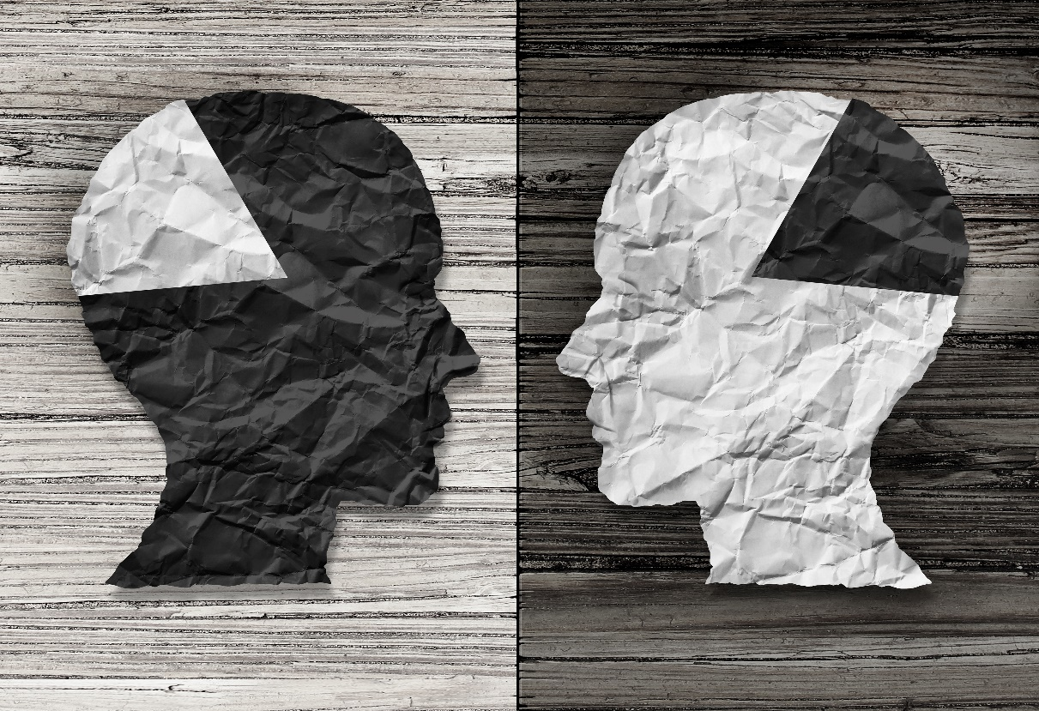
Stereotype vs. Bias Part 2: Scenarios

Slide 13
Breaking the Cycle: Strategy One
Become aware of our biases. “If you name it, you tame it”. You can achieve this through:
Harvard Implicit Bias Test : https://implicit.harvard.edu/implicit/
Challenge your filters: what stereotypes/ biases am I regularly exposed to? Use the Handout to guide you.
Self-regulate your feelings and thoughts.

Slide 14
Breaking the Cycle: Strategy Two
Prevent creation of new biases. You can achieve this through:
Diversifying your media consumption.
Connecting with people who are different than you.

Slide 15
Key Concepts
We all have filters that inform our worldview.
The cycle of prejudice and discrimination can result from stereotypes/bias.
We can work to prevent the creation of new biases and limit the impacts of our current biases.

